Slide 1
Digital Portfolio
Tamilarasai.E
STUDENT NAME:
REGISTER NO AND NMID:
DEPARTMENT:
COLLEGE: COLLEGE/ UNIVERSITY
asanm30224133021802522051/241330218025210 51
computer science department
Dr.R.K.S College of arts and science College Indili,Kallakurichi district. / Annamalai university

Slide 2
PROJECT TITLE
1.Simple Bank account

Slide 3


AGENDA
Problem Statement
Project Overview
End Users
Tools and Technologies
Portfolio design and Layout
Features and Functionality
Results and Screenshots
Conclusion
Github Link
3/21/2024 Annual Review

Slide 4

PROBLEM STATEMENT
1. Students need a simple project to understand basic banking operations.
2. Existing banking systems are too advanced for beginner-level learning.
3. Students find it difficult to practice real-time account handling safely.
4. A basic model is required to demonstrate deposit, withdrawal, and balance features.
5. A web-based system using HTML, CSS, and JavaScript helps students learn easily.

Slide 5

PROJECT OVERVIEW
This project is a simple web-based banking system created for students to learn the basics of online banking operations. It allows users to create an account with personal details such as Aadhaar number, phone number, age, gender, city, and pincode.
The system includes essential features like deposit, withdrawal, and balance checking. Developed using HTML, CSS, and JavaScript, it provides an easy-to-understand platform for students to practice and explore real-world banking concepts in a safe and user-friendly environment.

Slide 6

WHO ARE THE END USERS?
The primary end users of this project are students and beginners in web development. It is designed for those who want to learn how basic banking operations can be implemented using HTML, CSS, and JavaScript.
Apart from students, teachers and trainers can also use this project as a teaching aid. It helps in demonstrating simple account handling, deposit, withdrawal, and balance check in a safe and educational environment.

Slide 7

TOOLS AND TECHNIQUES
This project is developed using HTML, CSS, and JavaScript. HTML is used to create the structure of the banking system, CSS is applied to design and style the interface, and JavaScript is used to add functionality like account creation, deposit, withdrawal, and balance checking.
The techniques applied include form handling, DOM manipulation, and event-driven programming in JavaScript. Together, these tools and techniques make the system interactive, user-friendly, and suitable for students to understand the basics of web development and online banking operations

Slide 8
POTFOLIO DESIGN AND LAYOUT
The design of this project follows a simple and clean portfolio style layout. The homepage contains the bank name and a registration form where users can enter details such as Aadhaar number, phone number, age, gender, city, and pincode. A well-structured interface ensures that students can easily navigate and understand the flow of the system.
The layout is designed using HTML and CSS with clear sections for account creation, deposit, withdrawal, and balance checking. The background highlights the bank's name, while footer details show the city and pincode. This neat and responsive design makes the project attractive and easy for students to use and learn.
8

Slide 9
FEATURES AND FUNCTIONALITY
This project provides essential banking features such as account creation, deposit, withdrawal, and balance checking. Users can register with personal details like Aadhaar number, phone number, age, gender, city, and pincode, which are stored within the system.
The functionality is powered by JavaScript, which manages transactions and updates balances dynamically. With every deposit or withdrawal, the balance is recalculated instantly, ensuring accuracy. These features make the system practical for students to simulate real-life banking operations in a simplified manner.

Slide 10
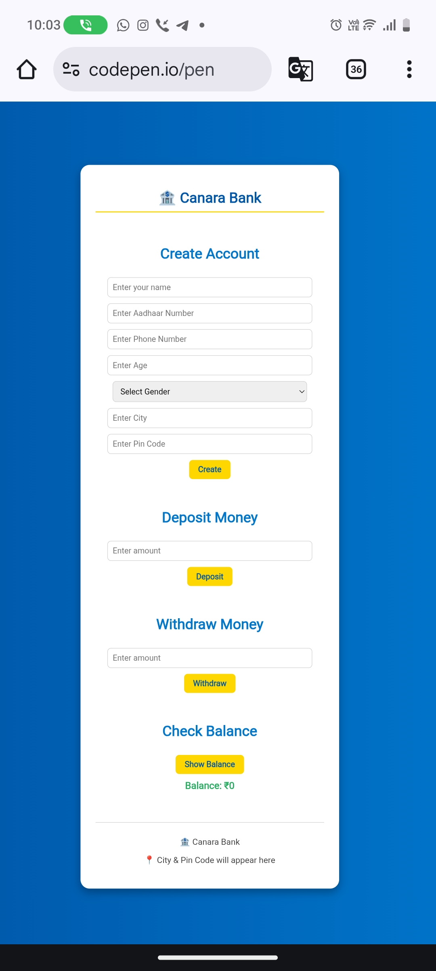

RESULTS AND SCREENSHOTS
3/21/2024 Annual Review
10

Slide 11
CONCLUSION
This simple banking system project demonstrates how basic financial operations can be implemented using HTML, CSS, and JavaScript. It provides an easy platform for students to learn the fundamentals of web development while simulating real-world banking features like account creation, deposit, withdrawal, and balance checking.
By focusing on simplicity and functionality, the project helps beginners understand both technical concepts and practical applications. It serves as a foundation for future projects, encouraging students to build more advanced and secure banking applications in the future.
11

